Slide 1

How to Choose A Great Red Wine
Tanishia Lewis – Entity Academy
Phoebe Moore – Entity Academy

Slide 2

Tanishia
Served in Non-profit most of my professional career with a focus on development and fundraising
Interested in data analysis for career growth, expansion in salary and a way to tie my love for cultural anthropology, food and data together.

Slide 3

Phoebe
Previously a Family and Consumer Sciences teacher
Interested in data analysis for the change in career path and many opportunities !

Slide 4
Project Introduction

Slide 5

Background on red wine
Characteristics of Red Wine Drinkers
Willing to spend $40 + dollars on a bottle on wine
Early Bird
More likely to be a “wine aficionado”
More likely to identify as adventurous, humble and organized
Introverted
Prefer dogs to cats
Where are the most popular places for red wine?
Italy,France,Spain,United States, Chile, Australia, China, Germany, South Africa, Portugal, Romania, Russia, Hungary, New Zealand
Why are certain regions better than others?
Mediterranean Vs elsewhere in the world
How does red wine impact the environment?
Climate change
Global warming
Greenhouse gas emissions
Notes:
Regions throughout the Mediterranean, as well as new world regions like California, Chile, and South Eastern Australia. Wines found in Mediterranean climates tend to be fuller bodied with lower acidity, higher alcohol, plus riper tannins and fruit flavors thanks to warmer temperatures.
Agriculture has a big influence on the environment, it contributes to climate change and global warming. With the use of fertilizers, pesticides, soil, land, water, and energy it’s responsible for approximately 20% of all greenhouse gas emissions. And wine production is no exception, the process of growing grapes and transforming it into wine, contributes to those effects as well.

Slide 6

Question 1 : What Factors Determine a Quality Wine ?
Why we chose this question
Let's help solve the age old question … “what exactly makes a quality wine”. Wine enthusiasts to novices all have pondered this exact topic; does one simply purchase the most expensive bottle? And how does sugar content and acidity levels impact that quality?
The dataset used, analyzed 1,599 entries from the Portuguese "Vinho Verde" wine set found on Kaggle.

Slide 7
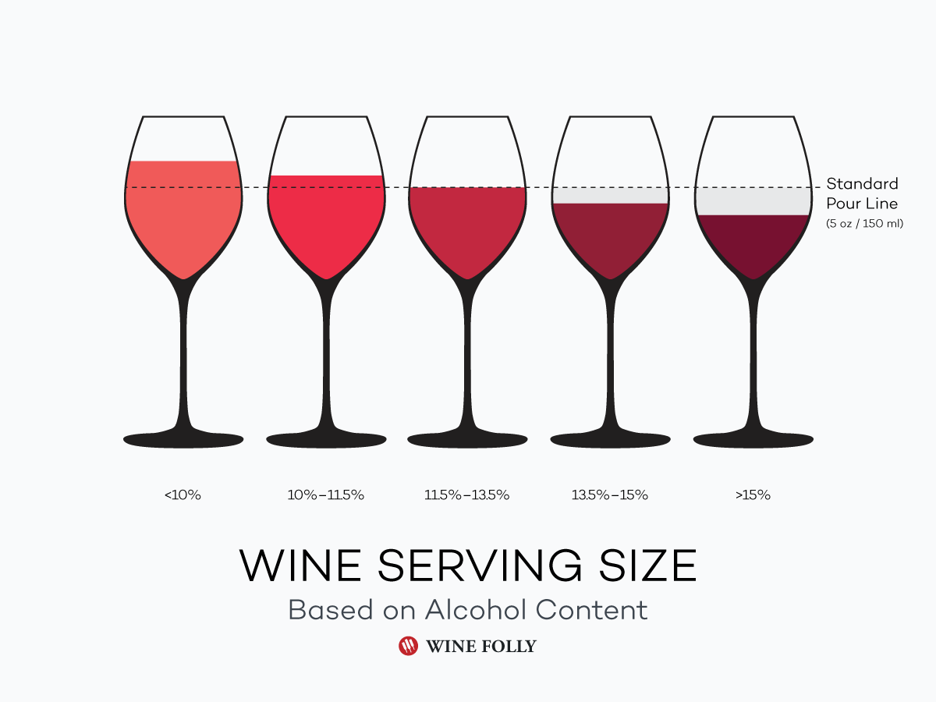
Question 2: Which factor has the most impact on the alcohol percentage in wine ?
Why we chose this question
Have you ever wondered why two similar bottles of wine could have differing alcohol contents? Or even why some types of wine are known to be higher than others?
Is this answer solved with basic food science? Or are there other factors to explore…

Slide 8
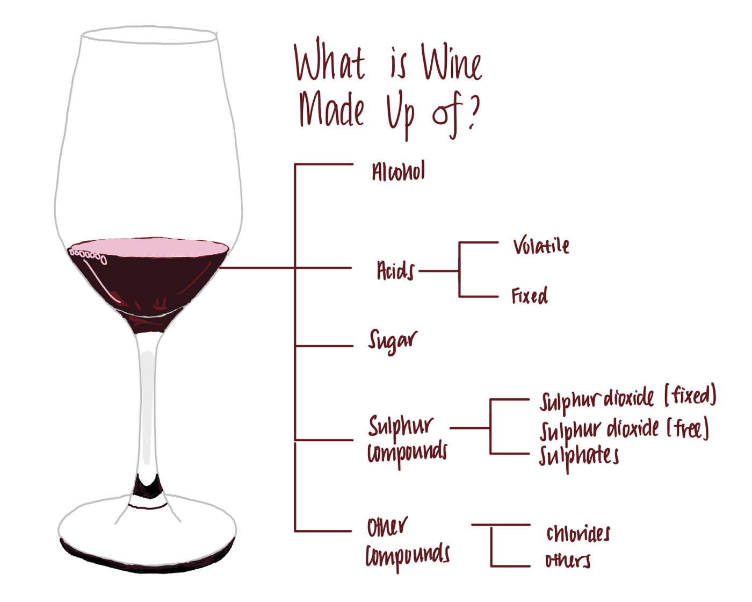
The variables were examined in during the process
Fixed acidity
Volatile acidity
Citric acid
Residual sugar
Chlorides
Free sulfur dioxide
Total sulfur dioxide
Density
Ph
Sulphates
Alcohol
Quality

Slide 9
Methods

Slide 10
Question 1 : What Factors Determine a Quality Wine ?
Chi Square Correlation test
In order to analyze how the continuous variables were impacted by each other a chi square correlation test was performed.
Stepwise Regression
Multiple R2 is 0.3606 which means that the model explains 36% of the variation in the quality variable and there is another 64% of the variation that can be chalked up to noise or random error
P-Value is less than .05 meaning that this model is better than model at all.
Notes:
Creating a contingency table using the corr. command on the entire data set produced the heat map showing the variables that impacted the quality of wine. BUT this is the reason we also picked another test to use...the chi-square

Slide 11
Question 2: Which factor has the most impact on the alcohol percentage in wine ?
Stepwise Regression
All 3 parts of stepwise regression yield same results that all variables were significant EXCEPT for free sulfur dioxide
From the forward and backward Stepwise Regression results my conclusions were :
Multiple R2 is 0.6699 which means that the model explains 67% of the variation in the alcohol percentage variable and there is another 33% of the variation that can be chalked up to noise or random error
The p-value was < 2.2e-16 which is less than .05 meaning that this model is better than no model at all

Slide 12
Results From Tests

Slide 13
Question 1 : What Factors Determine a Quality Wine ?
Stepwise Regression Results
The variables that impact the quality of the wine is : free sulfur dioxide , pH, total sulfur dioxide, chlorides, sulphates, volatile acidity, and alcohol content
Chi Square Correlation Test
The results produced by the test found that Alcohol and sulphates have the least impact on quality at 0.48% and the variables that impacted quality the most were volatile acidity, chlorides, with sulfur dioxide and density following closely behind.

Slide 14
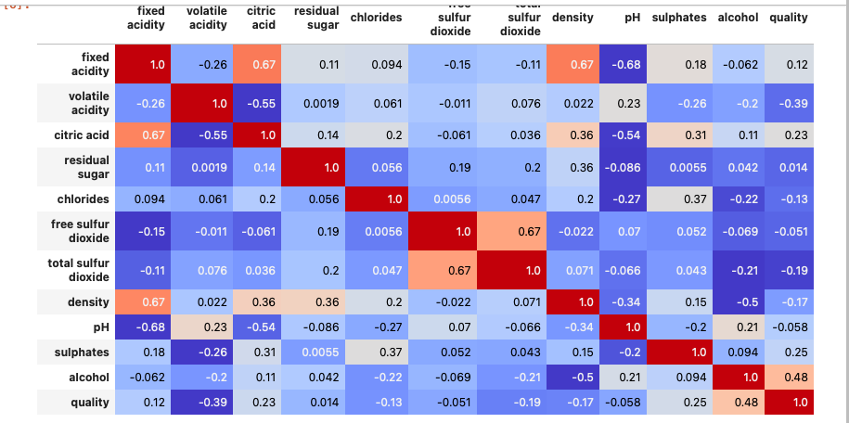
Independent Chi Square Correlation Test Results
Notes:
The results produced by the test found that Alcohol and sulphates have the least impact on quality at 0.48% and the variables that impacted quality the most were volatile acidity, chlorides, with sulfur dioxide and density following closely behind. Volatile acidity (VA) is a measure of the wine's volatile (or gaseous) acids. The primary volatile acid in wine is acetic acid, which is also the primary acid associated with the smell and taste of vinegar,chlorides being a major contributor to saltiness, Sulfur dioxide is used in winemaking as a preservative to prevent oxidation and microbial spoilage, gives an insight into the fermentation conditions and their favorability to yeast growth

Slide 15
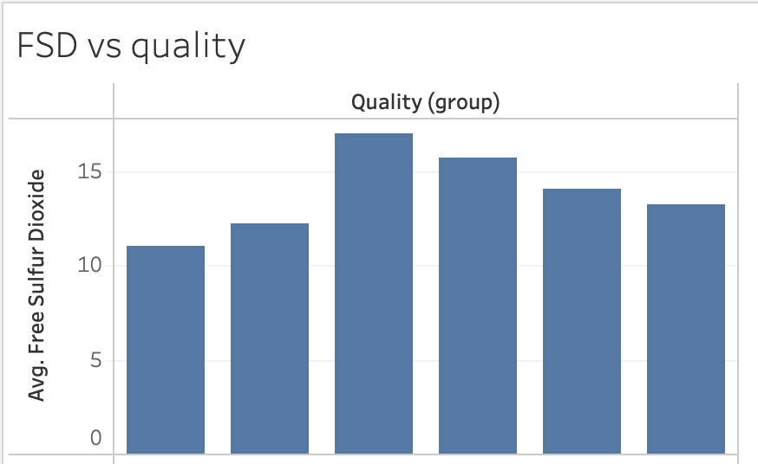
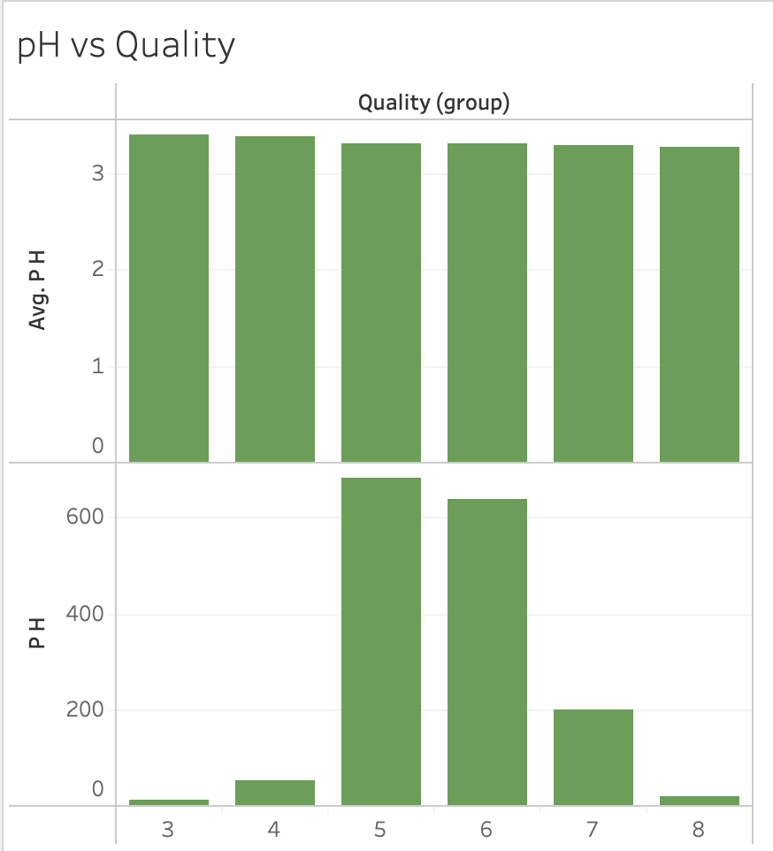
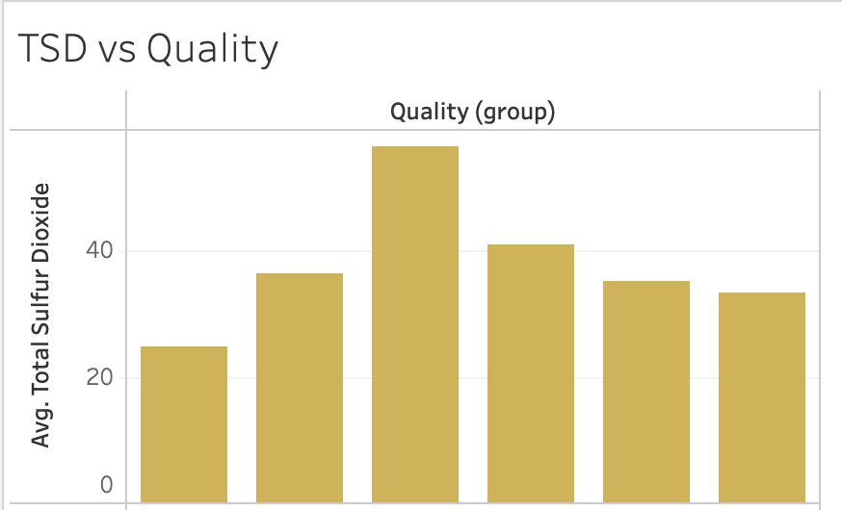
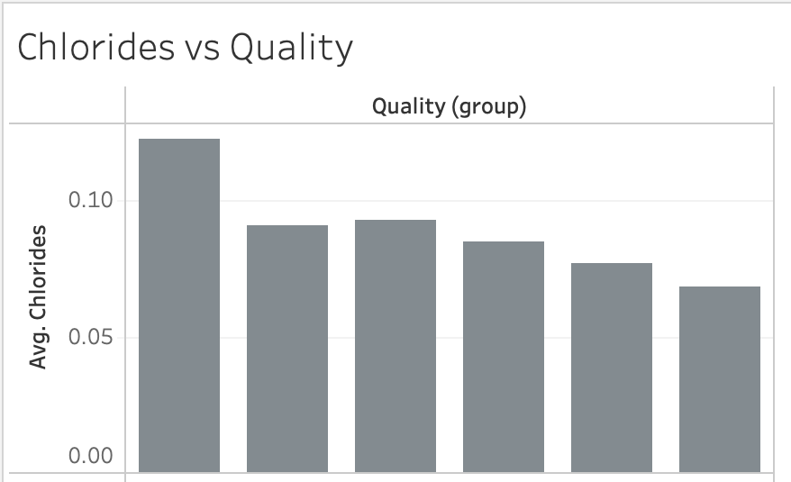
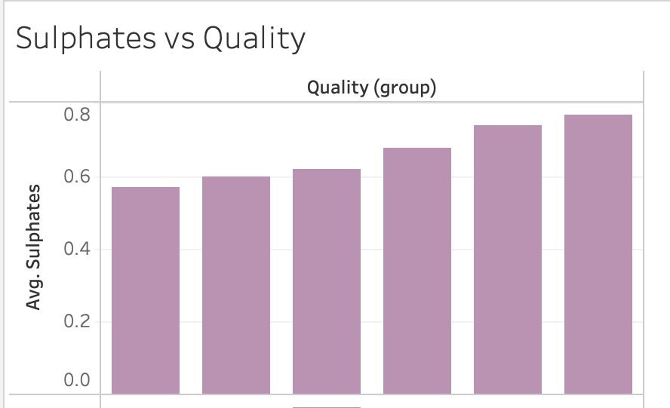
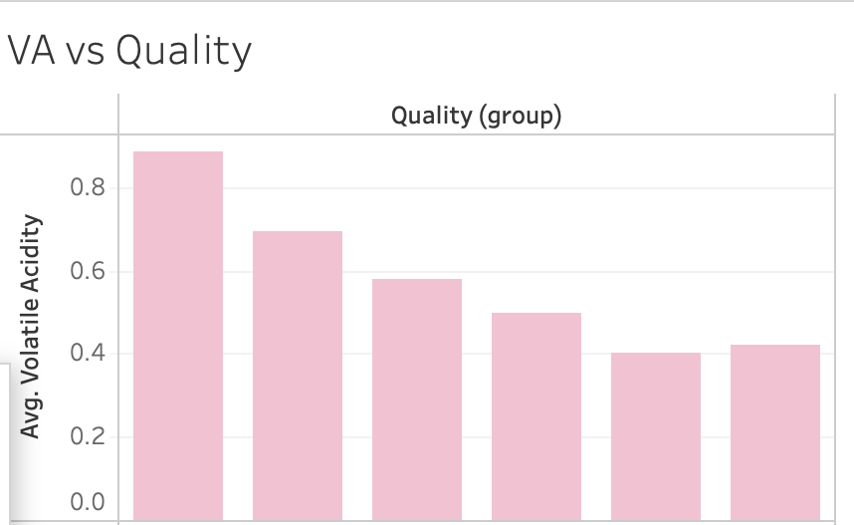
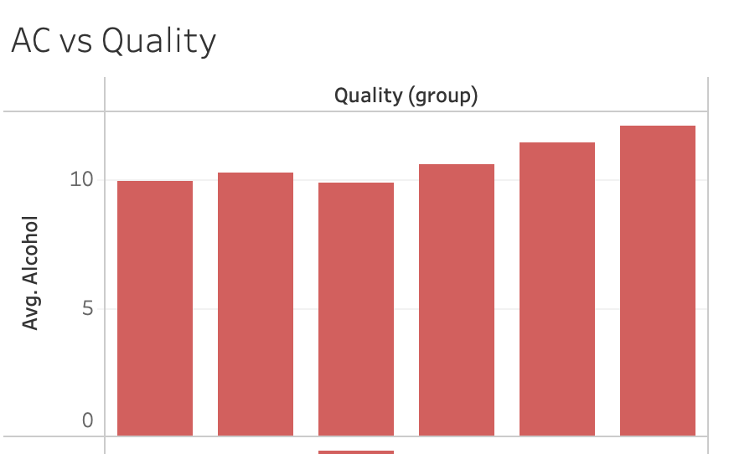
Stepwise Regression Results
Free Sulfur Dioxide
pH
Total Sulfur Dioxide
Chlorides
Sulphates
Volatile Acidity
Alcohol Content
Notes:
Many of the results produced via the Step Regression were similar except we see that there is a large impact the quality and sulfur dioxide, the volatile acidity also shows here that there is a large impact in the quality of the wince when there is less added which is contrary to what was found in the chi-square. he variables that impact the quality of the wine is : free sulfur dioxide , pH, total sulfur dioxide, chlorides, sulphates, volatile acidity, and alcohol content
The primary volatile acid in wine is acetic acid, which is also the primary acid associated with the smell and taste of vinegar. Volatile acidity is an important sensory note, with higher levels indicating wine spoilage.
Chlorides are the salt compounds found in wines. They assist with the color, clearness, flavor and aroma of the wine. They can either contribute to or detract from the overall taste and quality of the wine

Slide 16
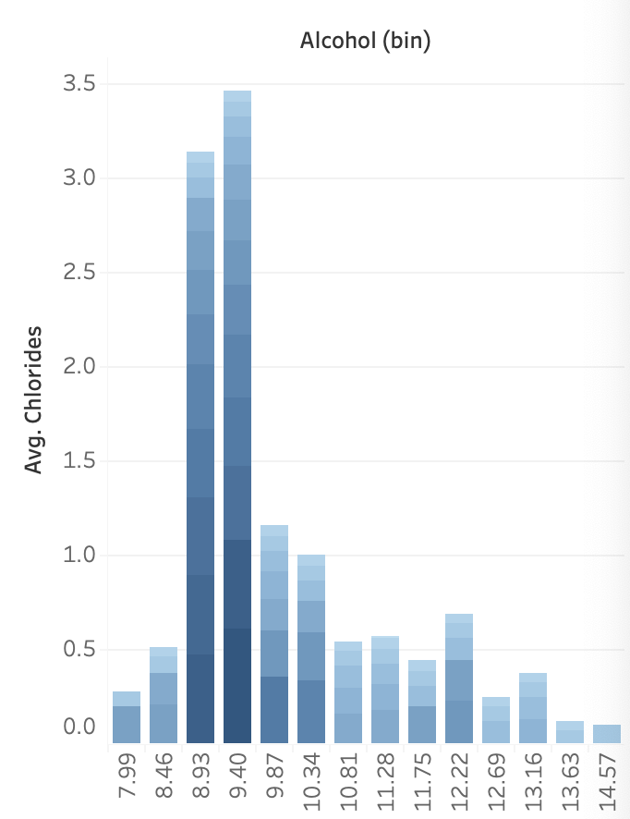
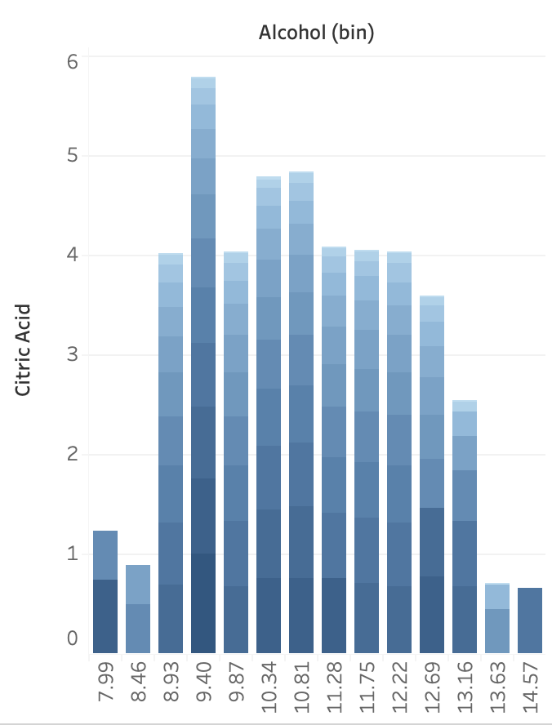
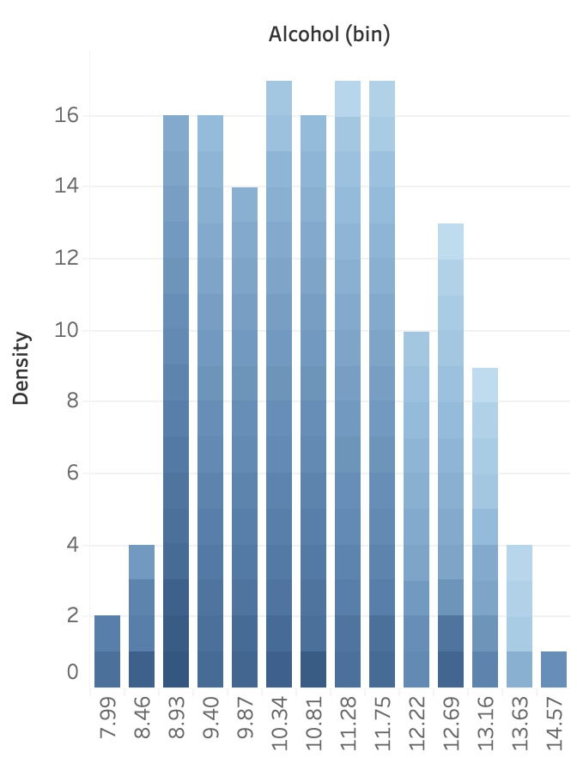
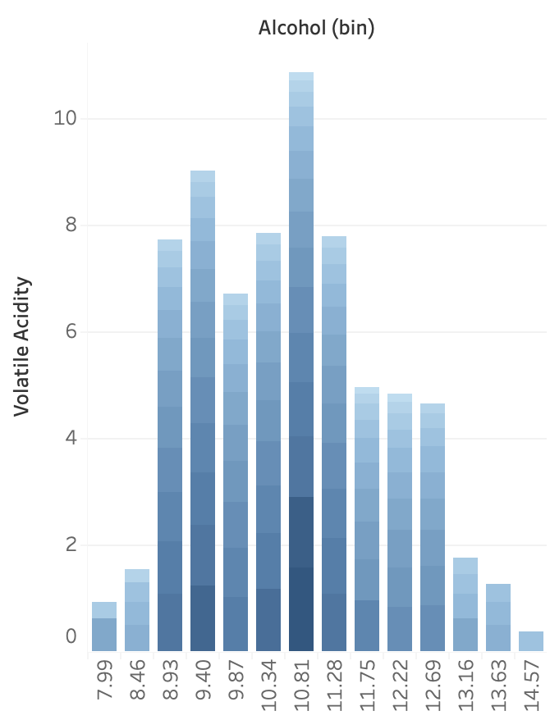
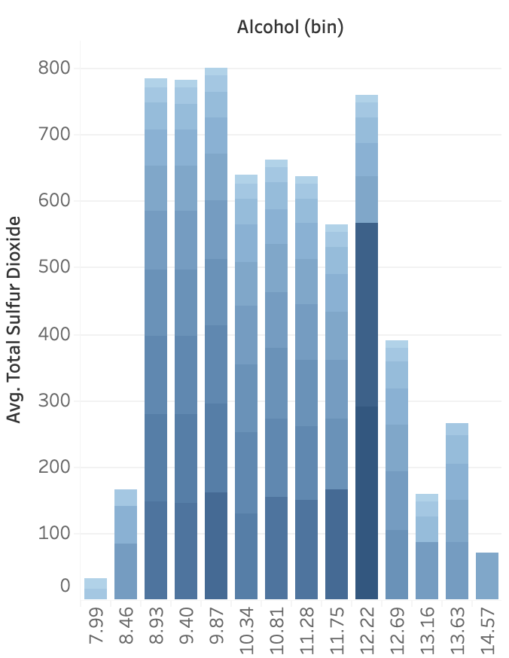
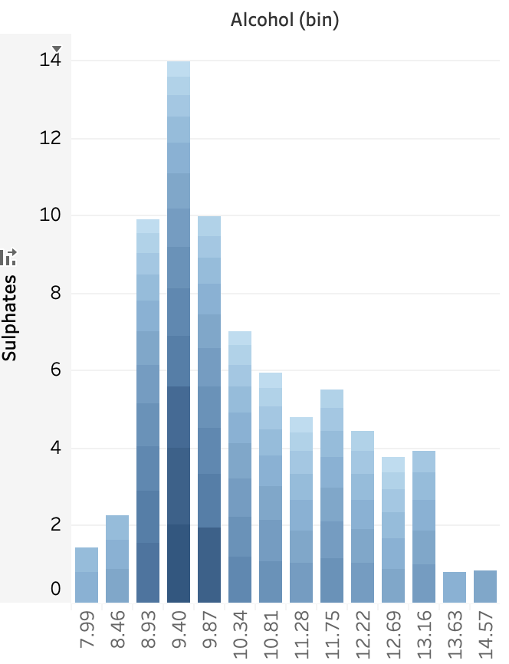
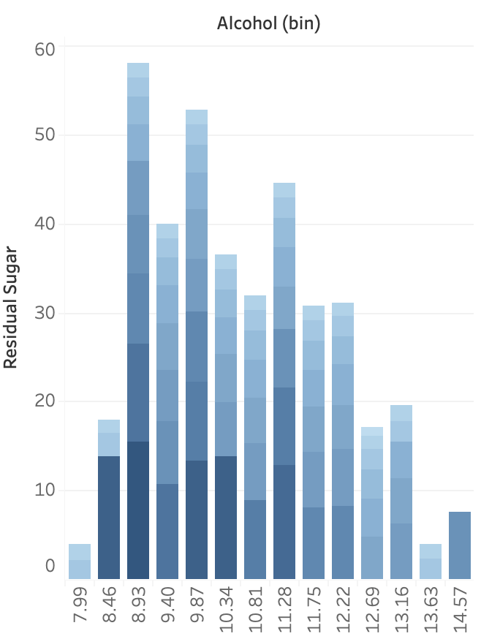
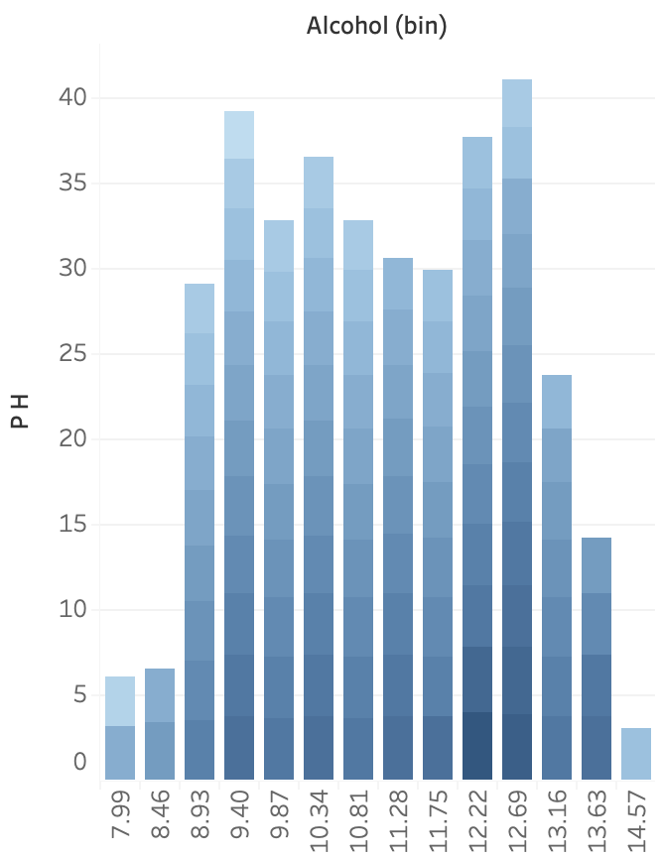
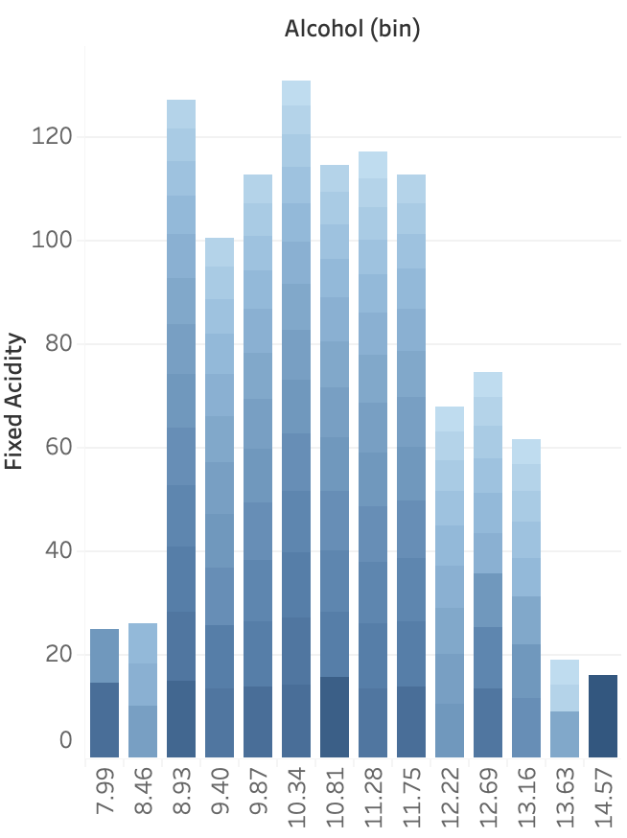
Question 2: Which factor has the most impact on the alcohol percentage in wine ?
Chlorides
Citric Acid
Density
Volatile Acidity
Total Sulfur Dioxide
Sulphates
Residual Sugar
pH
Fixed Acidity

Slide 17
Summary

Slide 18
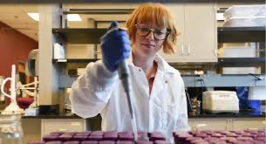
In summary, after analyzing the data and running several tests, quality is impacted by more than just simply the sweetness, tannins and acidity. We found that the amount of gaseous acids impacts the smell, and the resemblance of vinegar impacts the quality. The method that the winemaker chooses to use to preserve the wine also impacts the quality because typically they use sulfur dioxide.
The alcohol content in wine is influenced by most of the variables discussed but some are more impactful than others . We discovered that pH and acidity levels created during the fermentation process produce higher alcohol content wine. Whereas the wines that have a higher amount of salts called chlorides, have a lower percentage because they slow the fermentation process.

Slide 19
Conclusion

Slide 20

How can this impact others?
Wine is intimidating
Why is this work important?
It is important to know what your food is made of. Knowing how your drinks are made and why they are made that way is just a small step in making sure that you are making the right choices for yourself and your body

Slide 21
Questions?

